Slide 1
FAA/GMU Project
Development of AL MAT224 Dataset (V2.0)
AWG Annual Meeting
03/15/2018

Slide 2
Introduction – Revision Need
The previously released set of *MAT224 input parameters for Al-2024 did not produce accurate predictions for all six available sets of ballistic impact data
Since the original material model was released, additional mechanical property data has been created by OSU
  High rate Split-Hopkinson Bar tests, with full field strains measured by DIC, and temperature rise measured by high-rate thermal imaging
    We have become convinced that high rate data without DIC is misleading at best, and at worst, dangerous
  Testing to higher rates
  Failure strains at important, previously unmeasured states of stress, using newly designed test specimens
Therefore, it was appropriate to revise the FAA sponsored Al-2024 material model

Slide 3
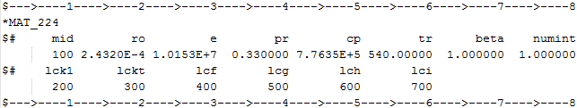
AL MAT224 Dataset
6 curves or tables
  LCK1– Hardening curves vs. Strain Rate
  LCKT – Hardening curves vs. Temperature
  LCF – Failure surface vs. Triaxiality & Lode parameter
  LCG – Failure strain scale factor vs. Strain Rate
  LCH – Failure strain scale factor vs. Temperature
  LCI – Failure strain scale factor vs. Element Size (Regularization)
  Beta - Fraction of plastic work converted into heat

Slide 4
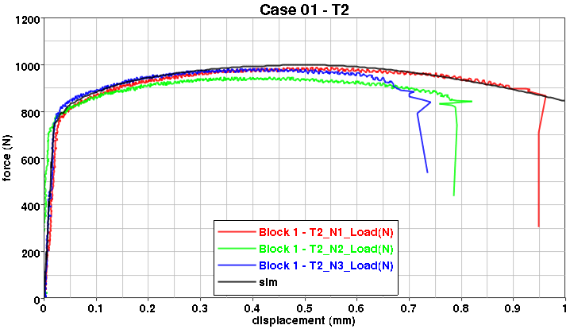
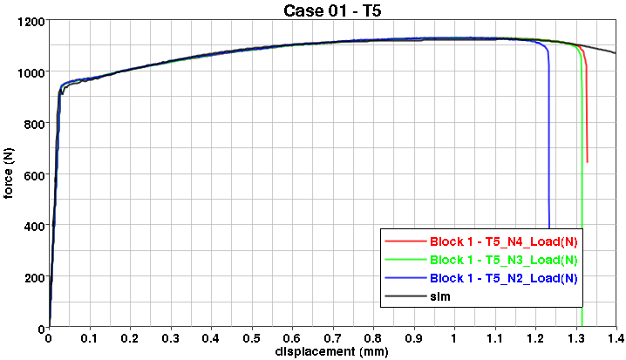
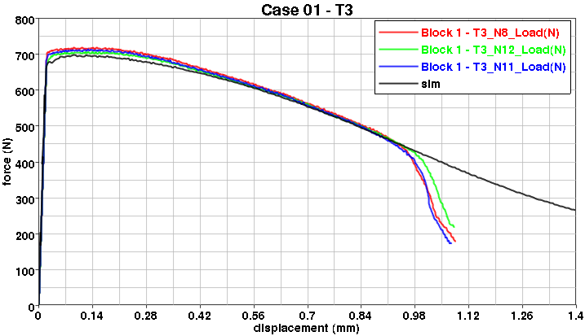
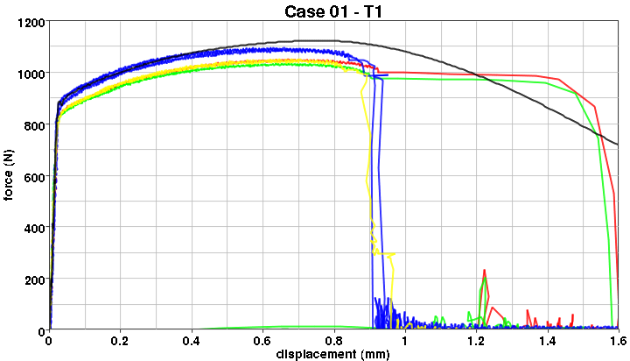
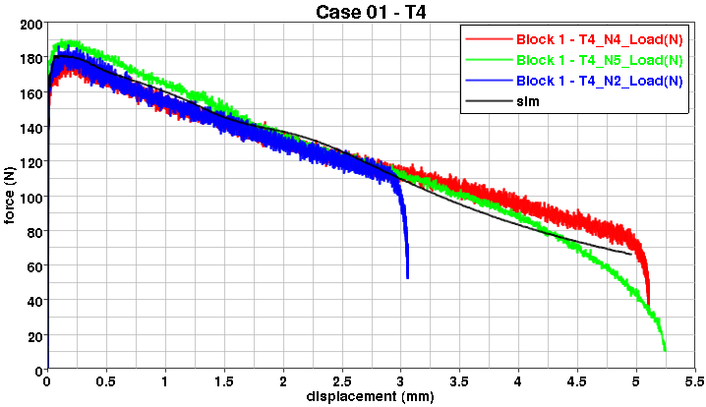
Temperature Series
5 temperatures
  T5=186K, T1=300K, T2=420K, T3=573K and T4=726K

Slide 5
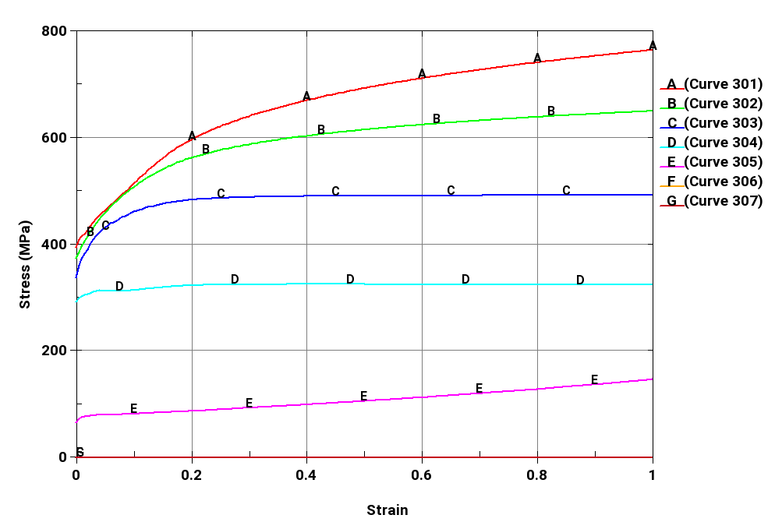
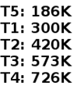
LCKT
LCKT are scaled down by the factor of SR2/SR3
  Temperature series was conducted at SR3 (strain rate)

Slide 6
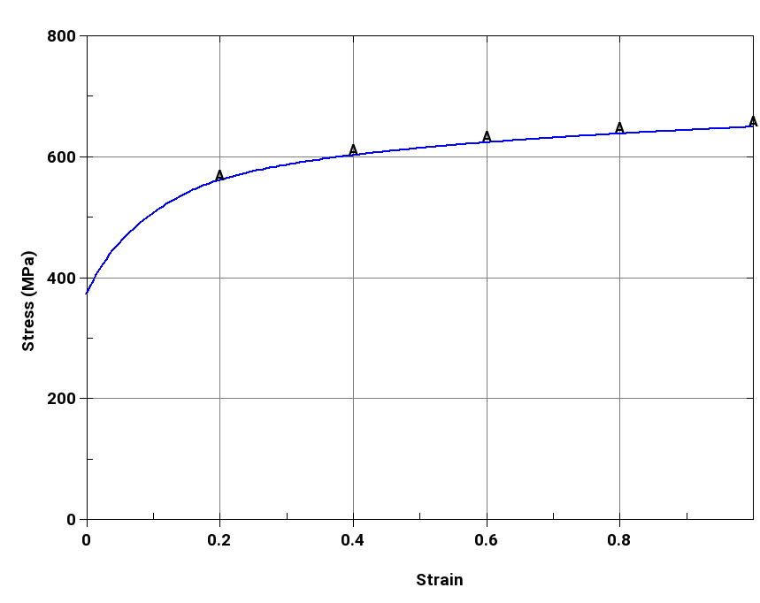
LCK1 (Quasi-static)
LCK1 (Quasi-static) is the same as T1(300K) of LCKT

Slide 7
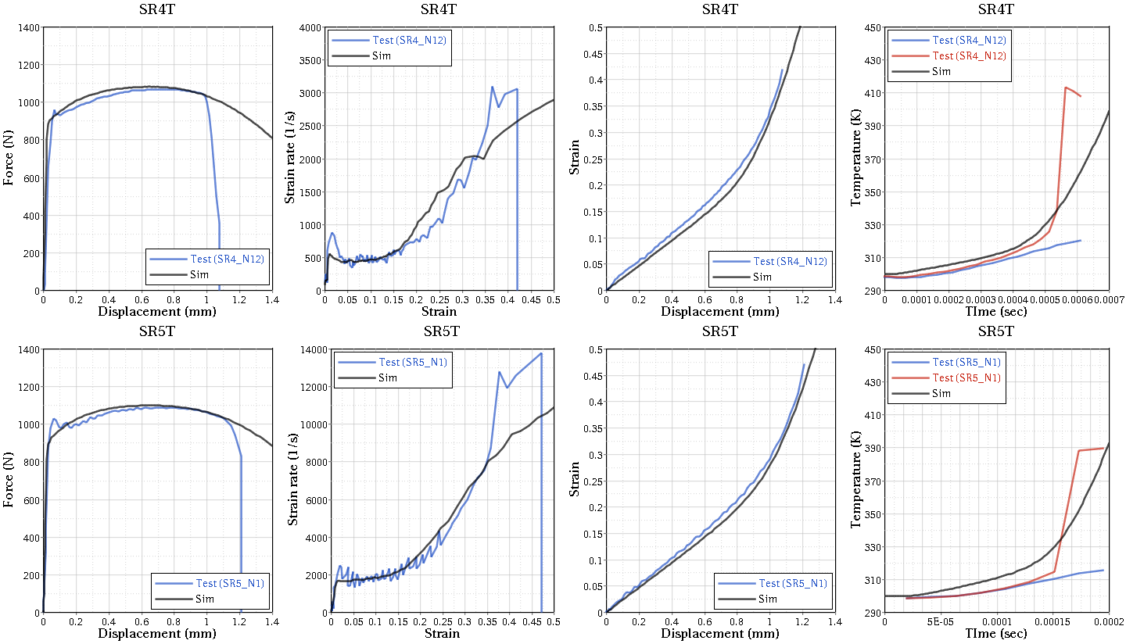
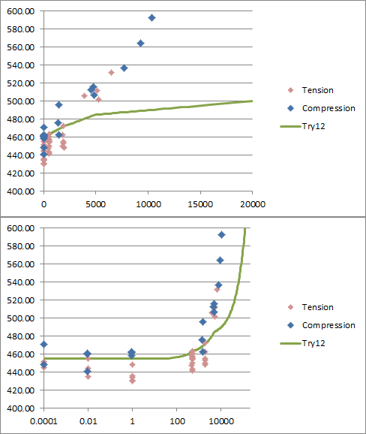
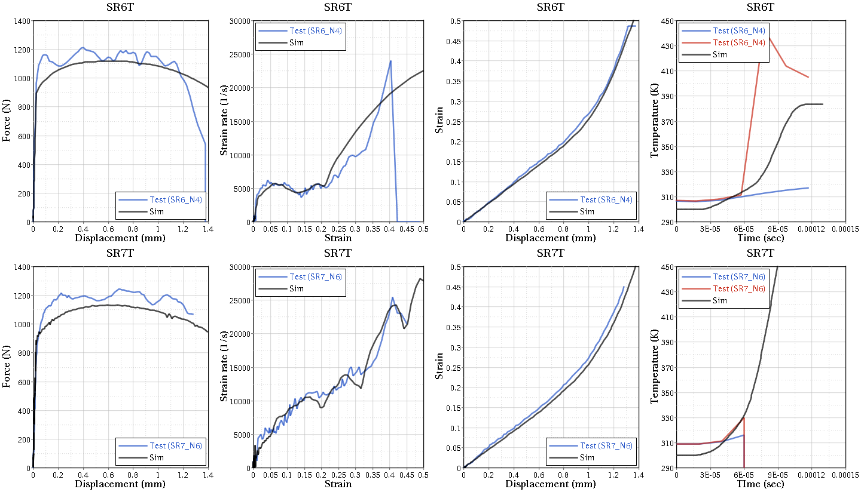
LCK1
Nominal strain rate shown below, but test was not isorate
β=0.4

Slide 8
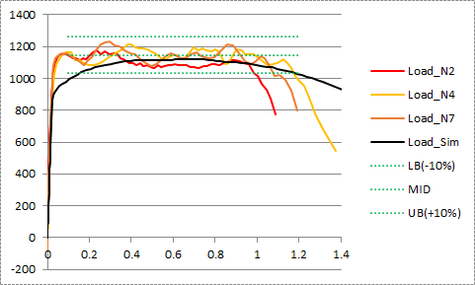
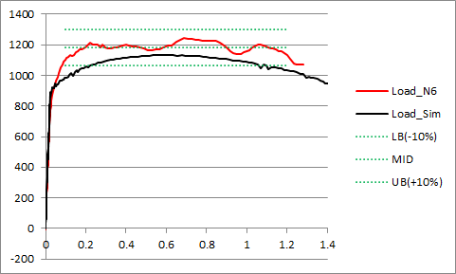
LCK1 (cont.)
Greater scatter at these highest, non-constant, rate tests
Force levels of simulations are within +/-10% error ranges of tests
SR6 SR7

Slide 9
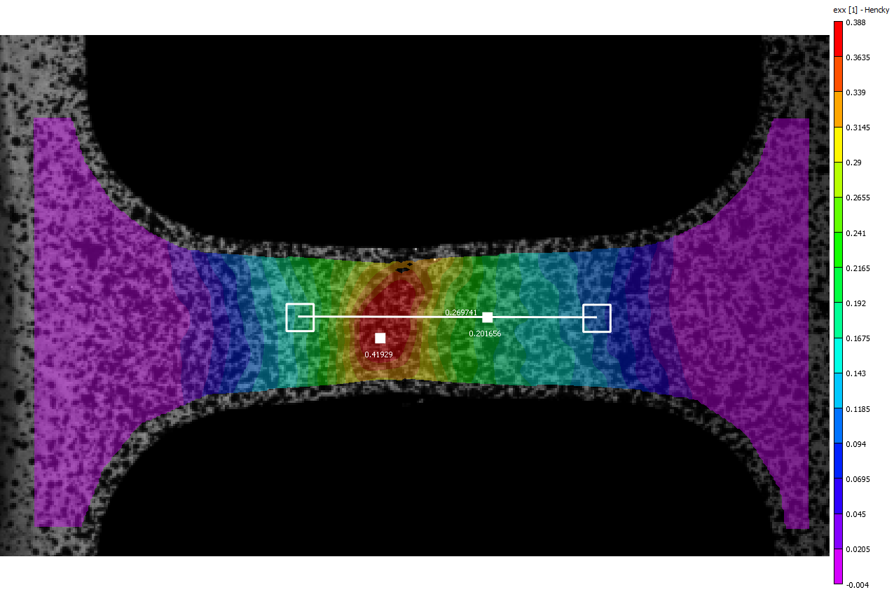
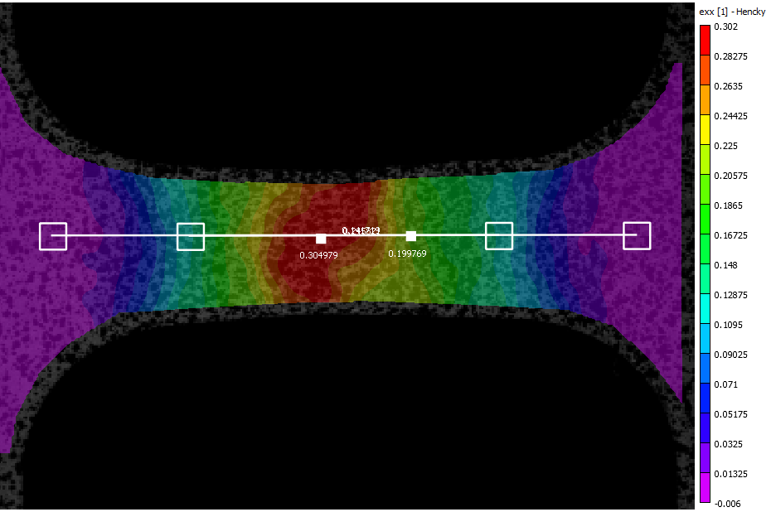
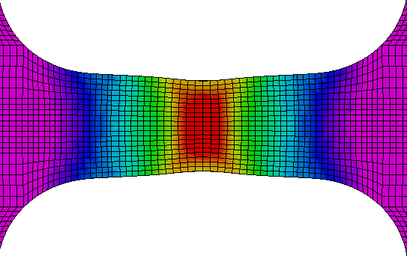
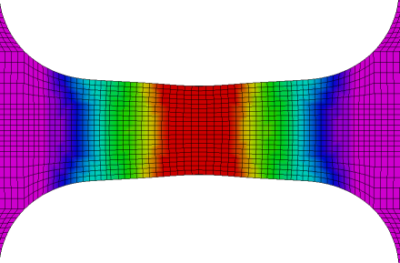
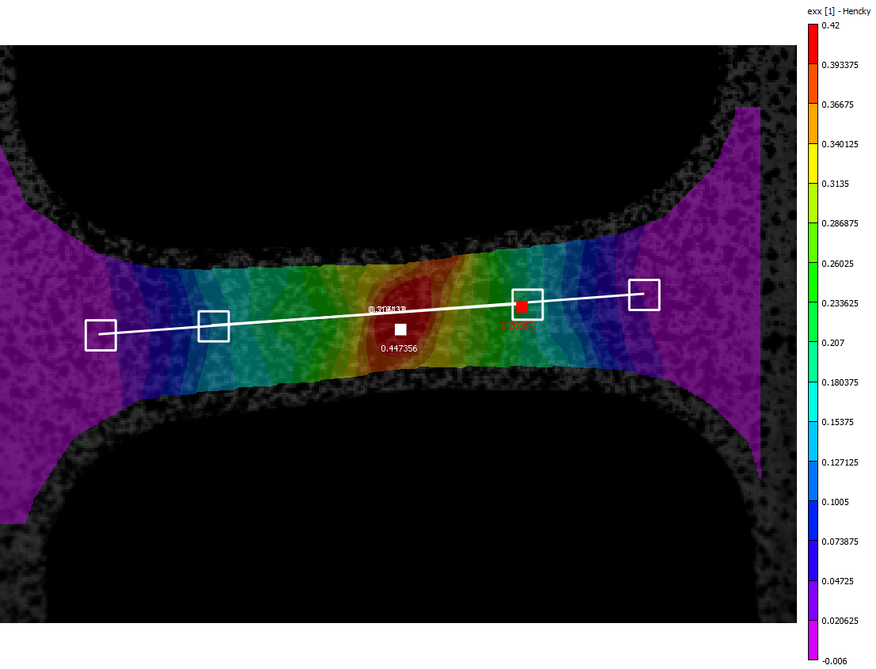
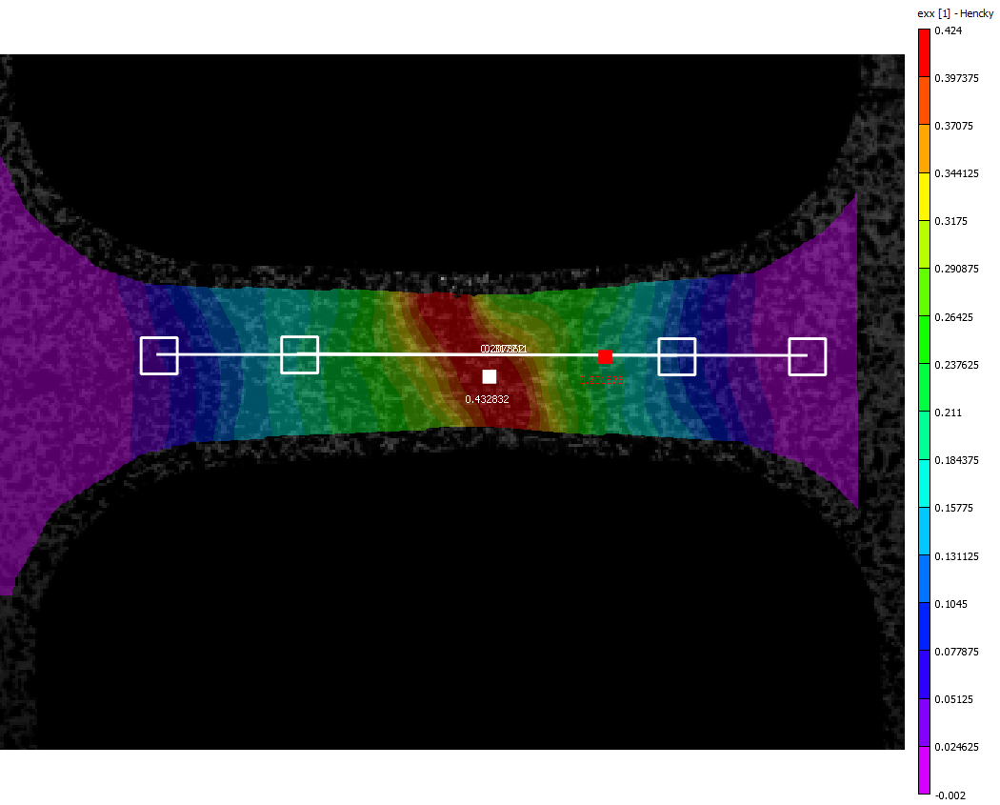
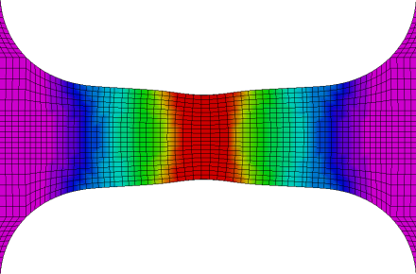
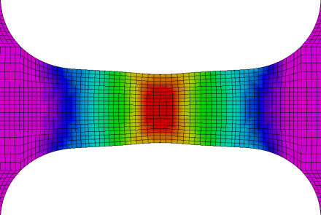
LCK1: Strain
SR4_N12 SR5_N1
SR6_N4 SR7_N6

Slide 10
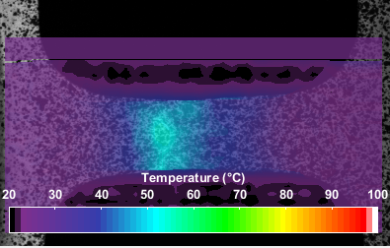
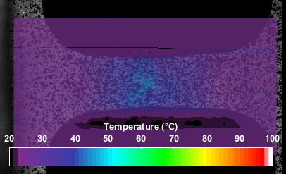
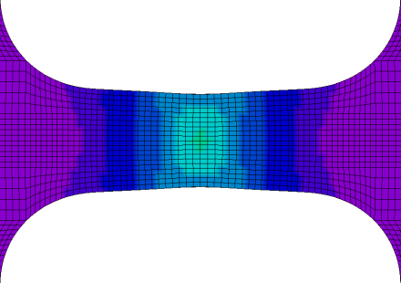
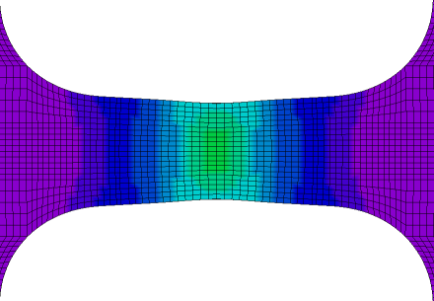
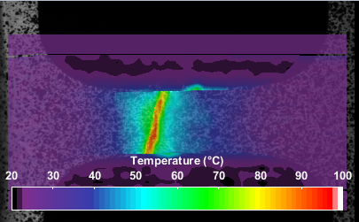
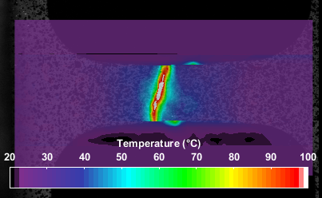
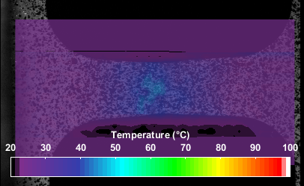
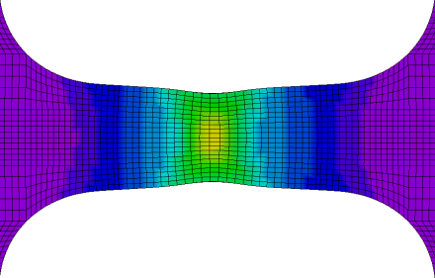
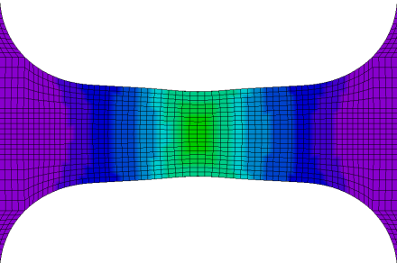
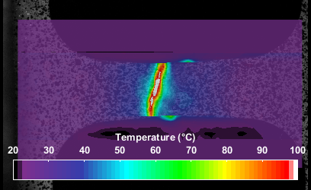
LCK1: Temperature (K)
SR4_N12 SR5_N1
SR6_N4 SR7_N6

Slide 11
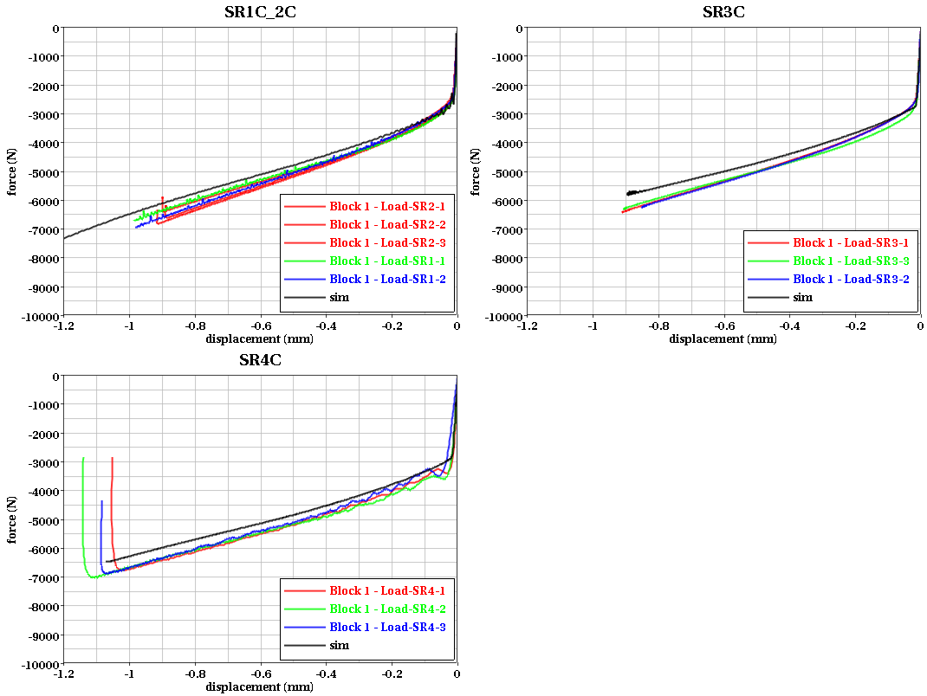
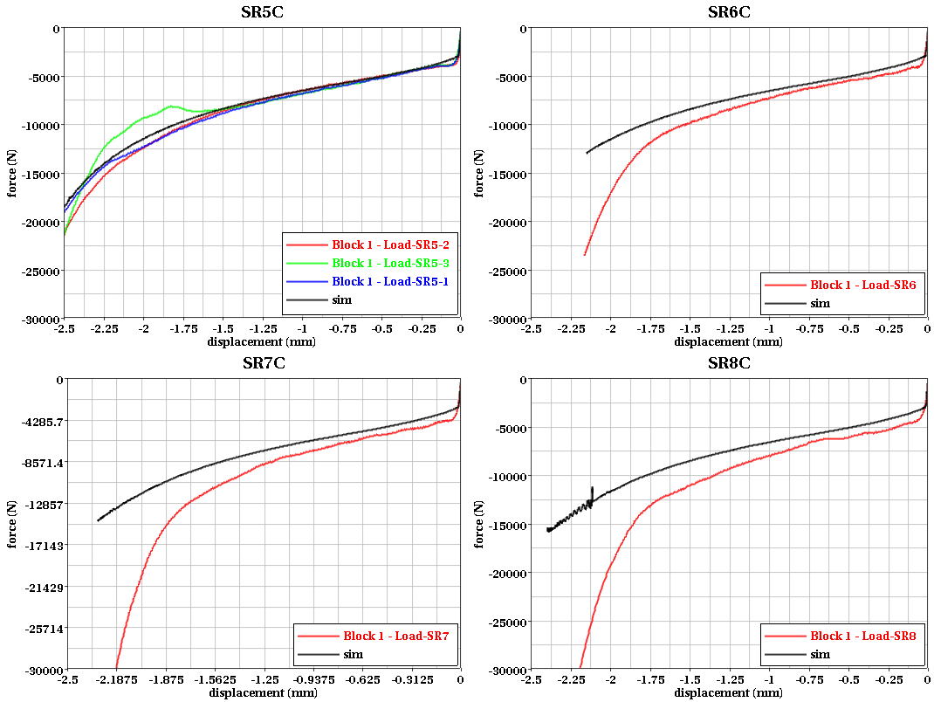
LCK1: Compression Rate Series
Tension and compression behavior is relatively symmetric
Compression | Strain rate
SR1 | 0.0001
SR2 | 0.01
SR3 | 1.0
SR4 | 1400
SR5 | 4500
SR6 | 7690
SR7 | 9271
SR8 | 10328

Slide 12
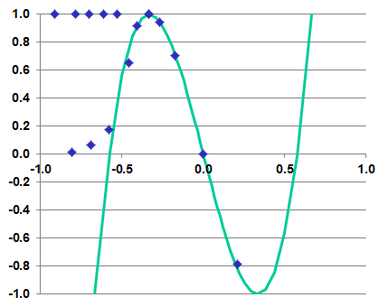
Failure Test Series
The triaxiality and Lode Parameter of these (or any) tests is never absolutely constant!
 |  | Tri |  |  | Lode angle |  |  | Epf
 |  | low | high | avg | low | high | avg | low | high | avg
Plane stress series | 1 | -0.36 | -0.40 | -0.38 | 1.00 | 1.00 | 1.00 | 0.21 | 0.30 | 0.25
 | 2 | -0.48 | -0.52 | -0.50 | 0.91 | 0.91 | 0.91 | 0.24 | 0.30 | 0.27
 | 3 | -0.55 | -0.56 | -0.56 | 0.62 | 0.62 | 0.62 | 0.23 | 0.26 | 0.25
 | 4
Axi-symmetric series | 5 | -0.34 | -0.53 | -0.43 | 1.00 | 1.00 | 1.00 | 0.16 | 0.43 | 0.29
 | 6 | -0.60 | -0.64 | -0.62 | 1.00 | 1.00 | 1.00 | 0.27 | 0.34 | 0.30
 | 7 | -0.67 | -0.68 | -0.67 | 1.00 | 1.00 | 1.00 | 0.28 | 0.29 | 0.29
 | 8 | -0.73 | -0.75 | -0.74 | 1.00 | 1.00 | 1.00 | 0.26 | 0.28 | 0.27
 | 9 | -0.78 | -0.80 | -0.79 | 1.00 | 1.00 | 1.00 | 0.22 | 0.25 | 0.24
 | 10 | -0.88 | -0.90 | -0.89 | 1.00 | 1.00 | 1.00 | 0.20 | 0.22 | 0.21
Plane strain series | 11 | -0.57 | -0.57 | -0.57 | 0.17 | 0.17 | 0.17 | 0.17 | 0.18 | 0.18
 | 12 | -0.65 | -0.66 | -0.66 | 0.08 | 0.08 | 0.08 | 0.19 | 0.22 | 0.20
 | 13 | -0.76 | -0.77 | -0.77 | 0.01 | 0.01 | 0.01 | 0.21 | 0.23 | 0.22
Compression | 14
Pure shear | 15 | 0.00 | 0.00 | 0.00 | 0.00 | 0.00 | 0.00 | 0.12 | 0.20 | 0.16
Tension-Shear series | 16 | -0.39 | -0.40 | -0.40 | 0.97 | 0.97 | 0.97 | 0.24 | 0.27 | 0.25
 | 17 | -0.17 | -0.17 | -0.17 | 0.64 | 0.64 | 0.64 | 0.20 | 0.24 | 0.22
New backed punch test series | Unbacked |  |  | -0.65 |  |  | -1.00
 | Thin |  |  | -0.10 |  |  | -0.75
 | Thick |  |  | 0.40 |  |  | -0.75
Compression-shear series | 21 | 0.21 | 0.21 | 0.21 | -0.78 | -0.78 | -0.78 | 0.44 | 0.44 | 0.44
 | 22 | 0.51 | 0.50 | 0.50 | -0.99 | -0.99 | -0.99 | 0.39 | 0.33 | 0.36
Unbacked
Backed
Thin
Backed
Thick

Slide 13
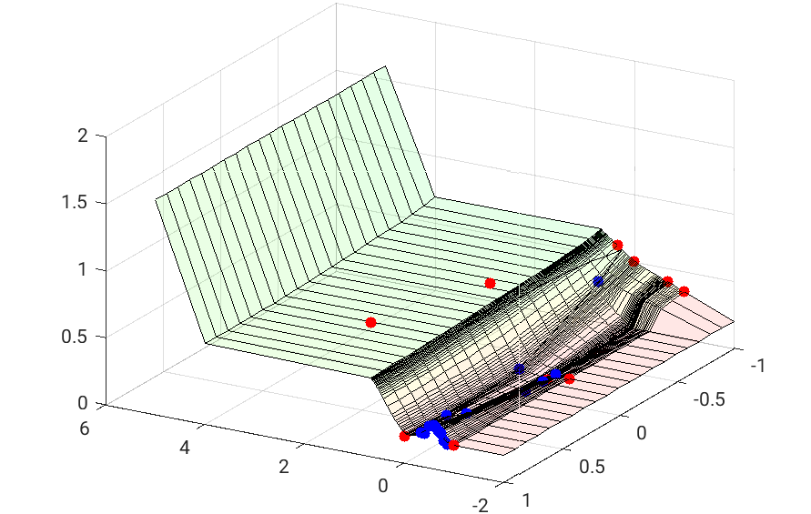
LCF
Quasi-static failure surface

Slide 14
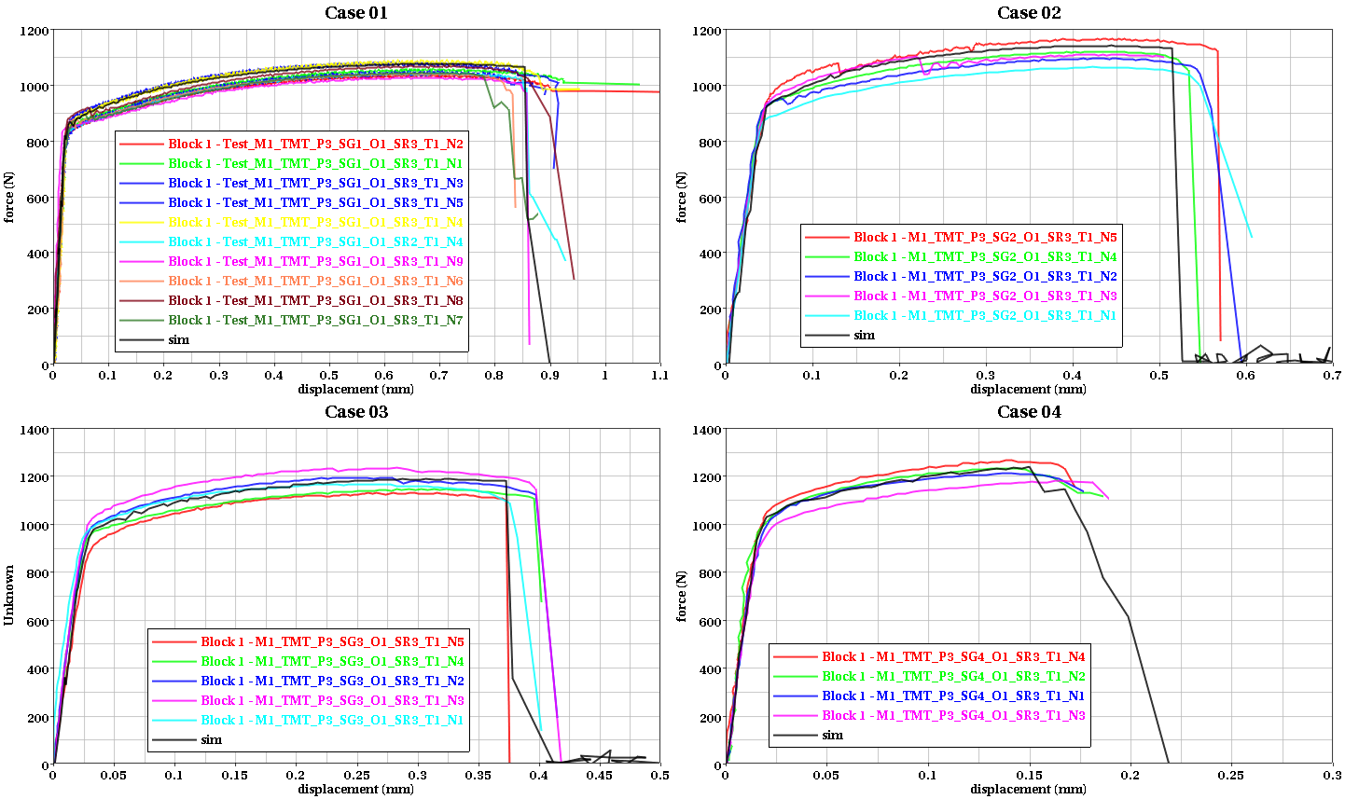
Plane Stress Series
Dogbone tension with varying notches (Case 01, no notch)

Slide 15
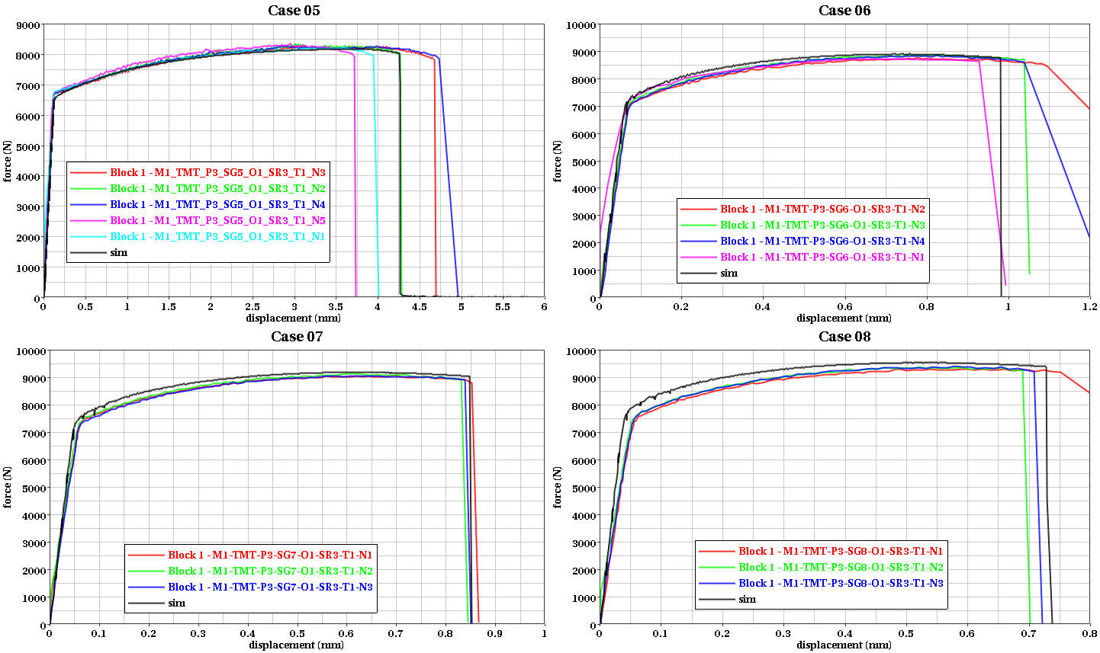
Axi-Symmetric Series
Circular tension with varying notches (Case 05, no notch)

Slide 16
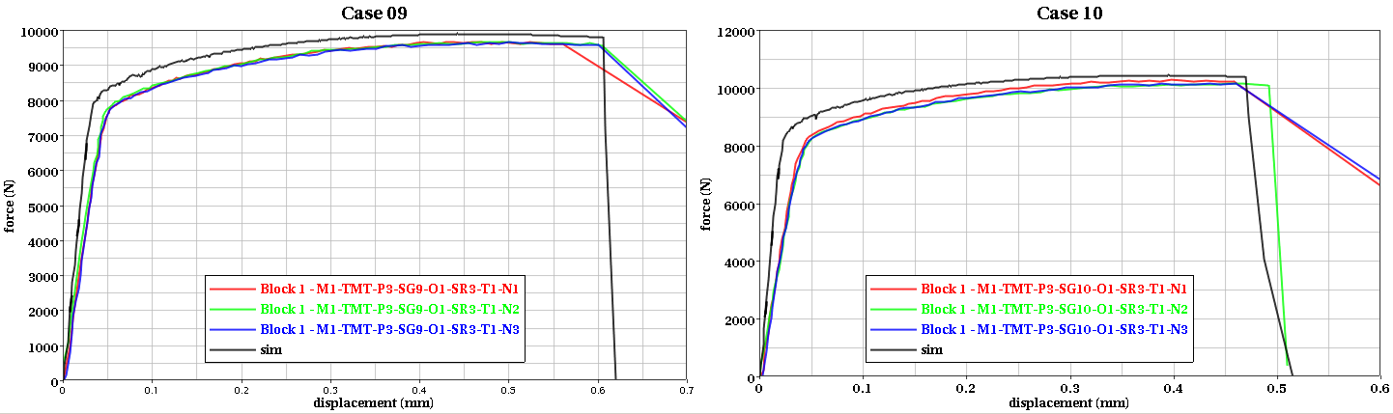
Axi-Symmetric Series (cont.)
Circular tension with varying notches

Slide 17
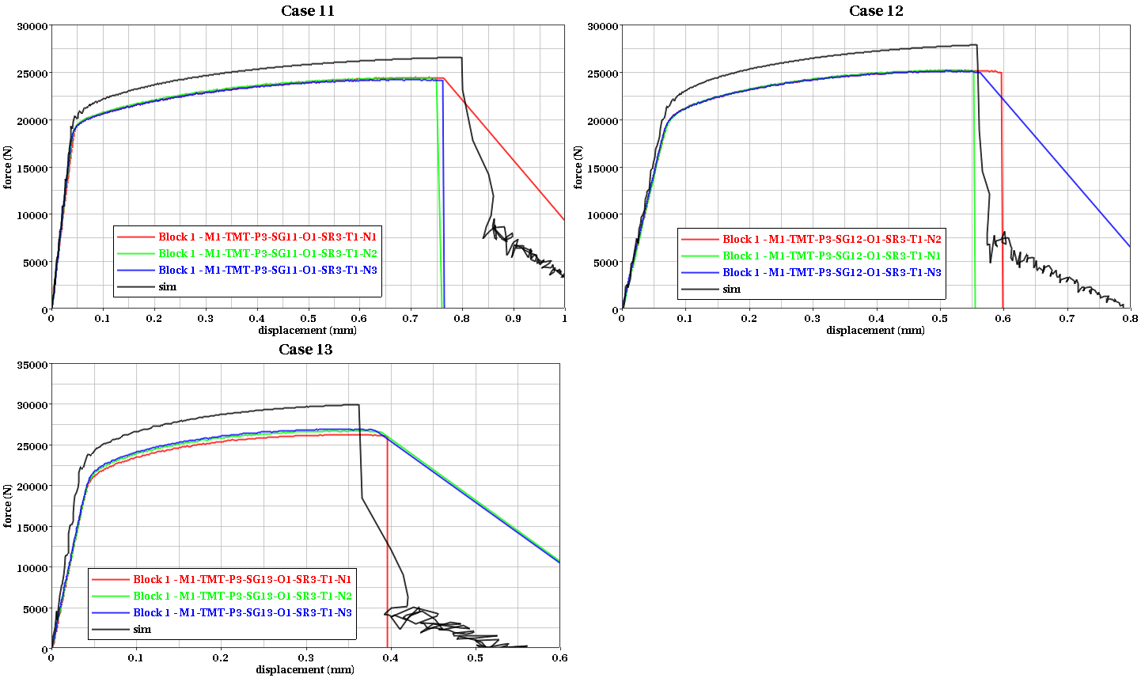
Plane Strain Series
Thick tension with varying notches (Case 11, no notch)

Slide 18
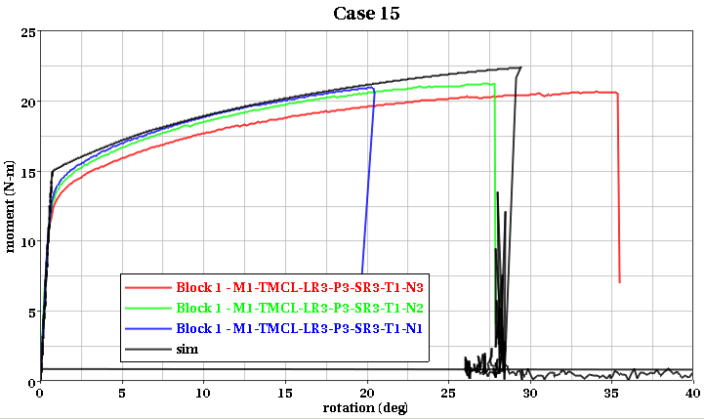
Pure Shear
Torsion

Slide 19
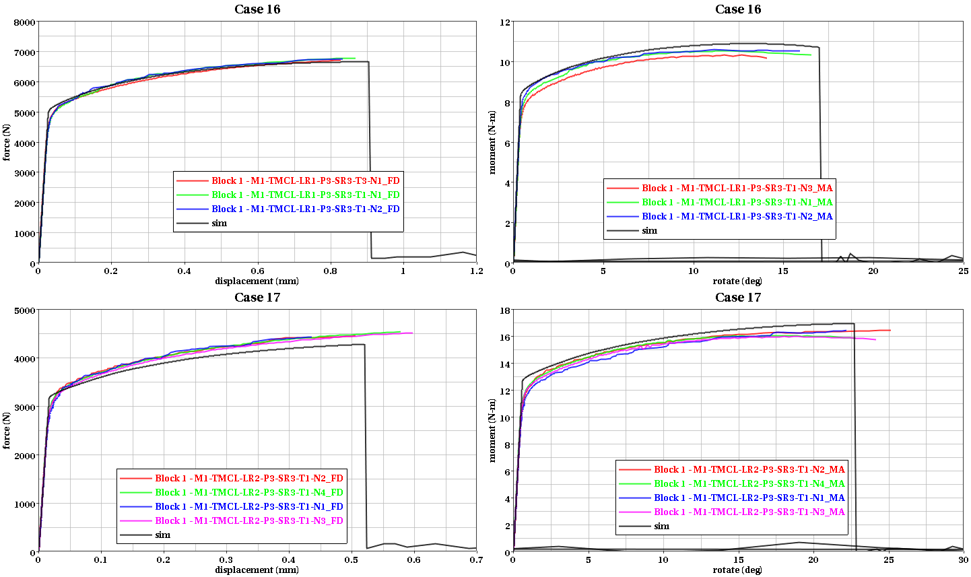
Tension-Shear Series
Axisymmetric, combined tension and torsion

Slide 20
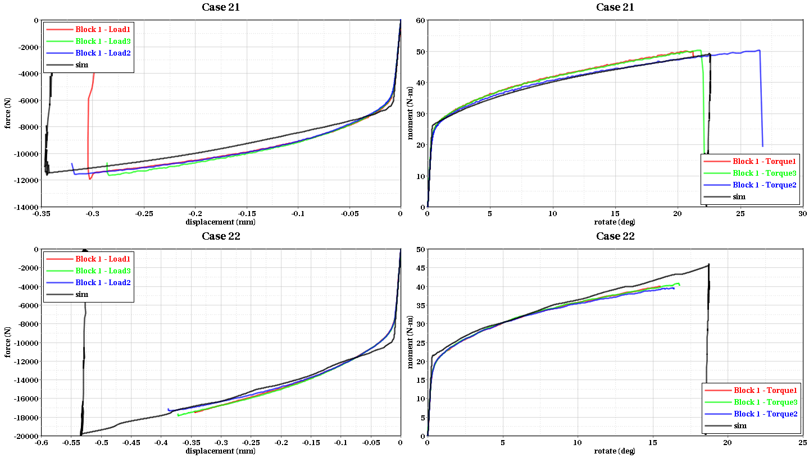
Compression-Shear Series
Axisymmetric, combined compression and torsion

Slide 21
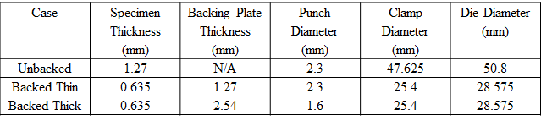
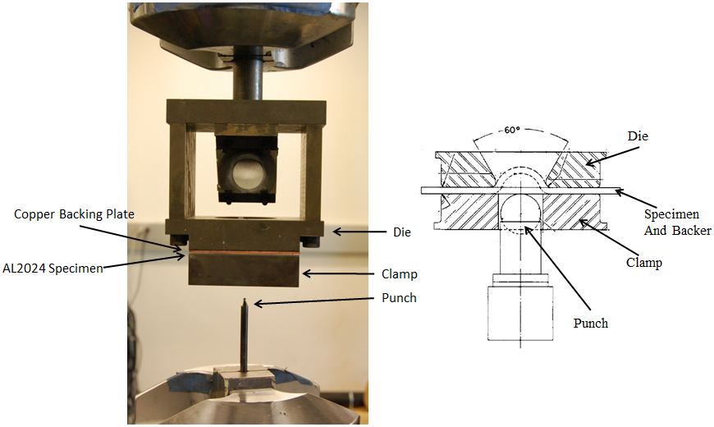
New OSU Punch Tests
Designed for Lode Parameter =-1 states of stress
These states of stress are common in ballistic impact, but are difficult to achieve in mechanical property tests
R0.8128mm

Slide 22
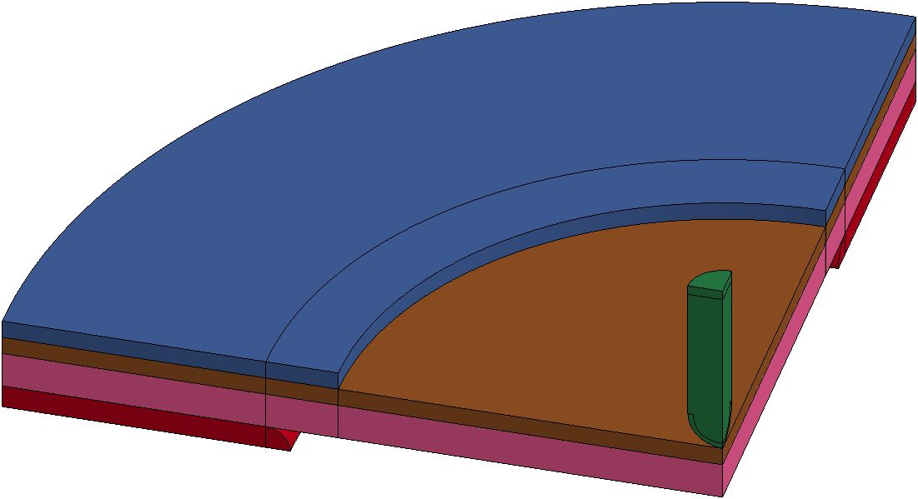
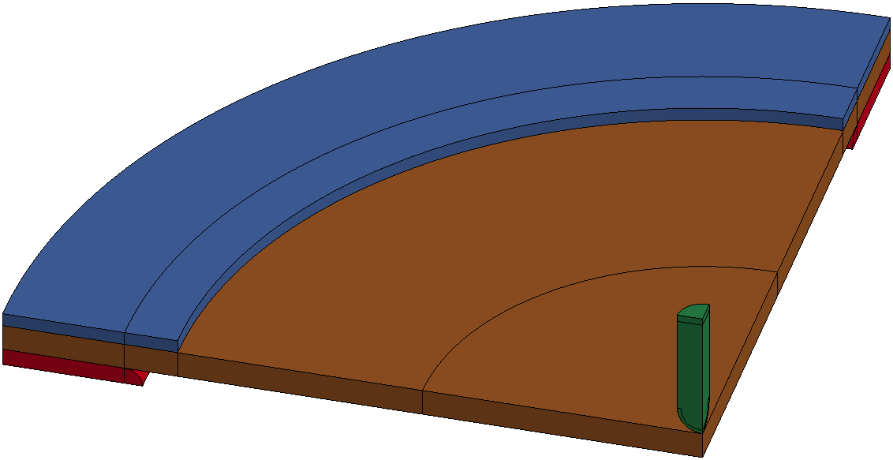
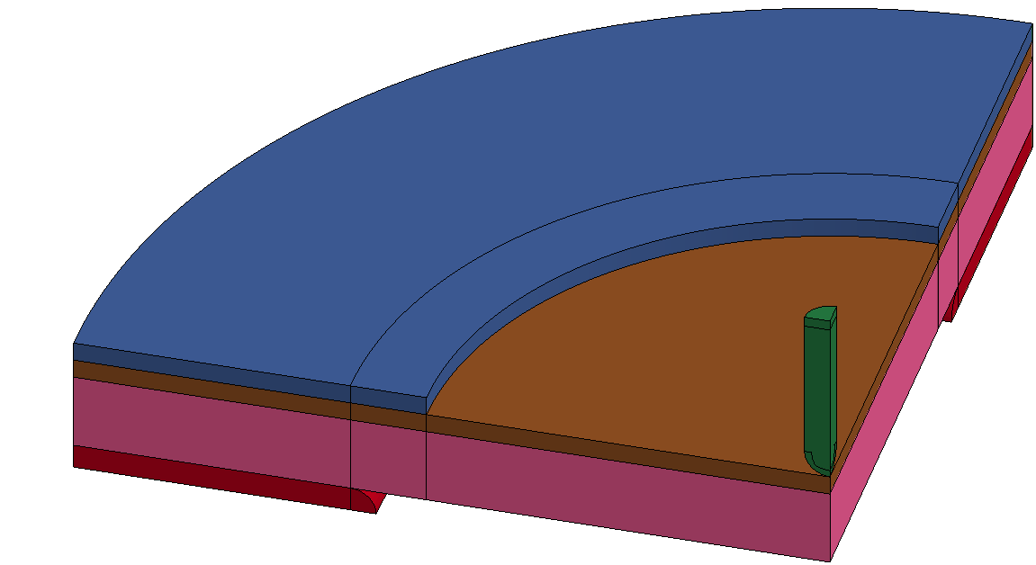
New Punch Tests: FE Model
Quarter symmetric model
Element size at impact area
  0.15 mm (average)
Number of elements through AL plate thickness
  Unbacked (t=1.27 mm): 8 elements
  Backed (t=0.635 mm): 4 elements
Quasi-static analysis
  No rate and temp. curves in MAT224-AL

Slide 23
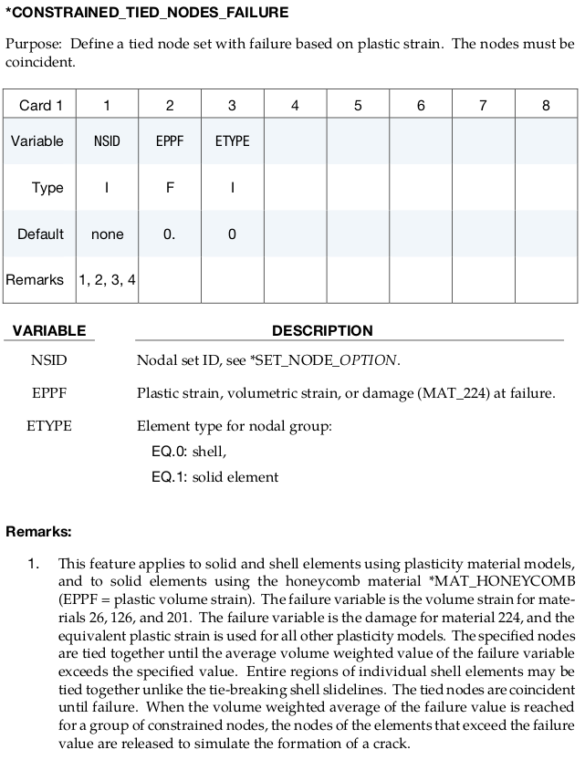
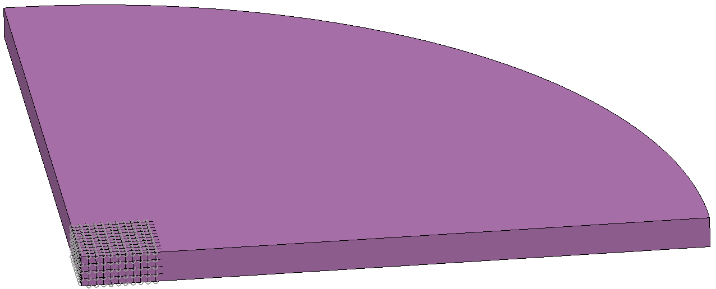
New Punch Tests:
*CONSTRAINED_TIED_NODES_FAILURE
Element erosion lead to loss of load path
To prevent element erosion
  Applied to two backed tests

Slide 24



New Punch Tests (cont.)
Unbacked test is approximately in bi-axial tension

Slide 25



LCG
Element erosion scaling, as function of strain rate
Try05

Slide 26

LCH
Scaling of element erosion as a function of temperature
 |  | Failure strain |  |  | Scale factor
SR3 | Temp. (K) | lower | upper | average | lower | upper | average
T5: 186K | 168 | 0.32 | 0.38 | 0.35 | 1.45 | 1.36 | 1.41
T1: 300K | 300 | 0.22 | 0.28 | 0.25 | 1.00 | 1.00 | 1.00
T2: 420K | 420 | 0.23 | 0.63 | 0.43 | 1.05 | 2.25 | 1.65
T3: 573K | 573 | 1.16 | 1.24 | 1.2 | 4.43 | 5.27 | 4.85
T4: 726K | 726 | 2.2 | 3.08 | 2.64 | 10.00 | 11.00 | 10.50

Slide 27




LCI
Lode = 1.0
Scaling of erosion by element size
Variations due to differences in localization
Lode-dependent regularization
  Mostly independent of Triaxiality
Case 10
Case 01
Lode = 0.0
Case 11
Case 15
Lode = -1.0
Case 21
Case 22

Slide 28




LCI: Case 01 & Case 10
Plane Stress
w/o Reg.
w/ Reg.
Axisymmetric
w/o Reg.
w/ Reg.

Slide 29




Case 11 & Case 15
w/o Reg.
Plane Strain
w/ Reg.
w/o Reg.
Pure Shear
w/ Reg.

Slide 30


LCI: Case 21 – Compression Torsion
w/o Reg.
w/ Reg.

Slide 31


LCI: Case 22 – Compression Torsion
w/o Reg.
w/ Reg.

Slide 32

Ball Impact Test - U.C. Berkeley
Plate
  Aluminum 2024-T3
  Dimension: 12-inch by 12-inch square
  3 thicknesses
    0.0623 (1/16) inch
    0.125 (1/8) inch
    0.25 (1/4) inch
Ball
  ½-inch-diameter chrome steel sphere
  Mass: 0.29 oz. (= 0.018125 lbf = 8.3 gram)

Slide 33

Cylinder Impact Test – NASA GRC
Plate
  Aluminum 2024-T3
  Dimension: 10-inch-diameter circle
  3 thicknesses
    Plate1: 0.125 (1/8) inch
    Plate2: 0.25 (1/4) inch
    Plate3: 0.5 (1/2) inch
Cylinder
  ½-inch-diameter Titanium & Steel cylinders
  Mass (varied cylinder lengths for different masses)
    9.9 gram for Plate1 (Titanium cylinder)
    12.8 gram for Plate2 (Titanium cylinder)
    28.0 gram for Plate3 (Steel cylinder)

Slide 34


Impact Test Simulations
Sphere
Cylinder

Slide 35

Sphere Impact (cont.)
AR-07/26
MAT224 Dataset (V2.0)
Johnson Cook Material Model and Results from 2007 FAA Report

Slide 36
Summary
Al-2024 MAT224 Dataset (V2.0) is essentially complete
FAA will perform checkout of the model
Documentation will be completed
Model demonstrates good predication capability for a variety of ballistic impact tests
  Varying plate thicknesses, velocities, projectile shapes and materials
Qualifications and considerations:
  Very high strain rates required extrapolation of high rate behavior
  Limited correlation of the failure surface in compression was required
    Three failure strains with positive triaxiality is a big improvement over what was previously available
    For V1.0 no failure strains with positive triaxiality were available
    However, three failure strain values does not define the complete positive triaxiality region of the failure surface!

Slide 37
Thanks

