Slide 1
Ice 2019
LS-DYNA ERIF AWG
Dr. Kelly Carney
ERIF AWG Member Emeritus
George Mason University and FST LLT

Slide 2
Issue
Several years ago LSTC corrected a bug in the advection algorithm of the LS-DYNA ALE implementation
This bug fix caused the current AWG Test Suite Ice model to no longer match test data
Limited tuning parameters exist in the Ice model
  Only the EOS was not based upon mechanical property test data
Limited time resources have not allowed an investigation into revising the EOS until very recently

Slide 3
References
Carney K., Benson D., DuBois P., Lee R., “A Phenomenological High Strain Rate Model with Failure for Ice”, International Journal of Structures and Solids 43 (2006) 7820-7839.
Carney K., Benson D., DuBois P., Lee R., “A Phenomenological High Strain Rate Model with Failure for Ice”, 9th International LS-DYNA Users Conference, 2006.

Slide 4
Ice EOS and Bulk Modulus
The bulk modulus used in the Test Suite ice model was based upon the generalized Hooke’s law
A pressure limit was included in the EOS (*EOS_COMPACTION_TABULATED), and was described as a need to eliminate high frequency oscillations which led to premature failure
The bulk modulus of the many varieties of ice is not consistent with Hooke’s law
Ice bulk modulus increases with pressure
A much better reason justification for using the pressure limit is that as ice turns to water, it contracts
  Any liquification in an ice projectile will limit pressure increases, and can be modeled in the EOS
  In a hydrostatic pressure response, this liquification will look very similar to a pressure limit used in compaction
  This explanation was mentioned in the LS-DYNA Users Conference presentation, but was not included in the Ice Model Journal Article

Slide 5
Ice Bulk Modulus and EOS References
When water freezes it expands by ~9% (many publications and references)
Ice will melt when shocked
  Stewart and Ahrens, HUGONIOTS AND SHOCK-MELTING CRITERIA FOR SOLID AND POROUS H2O ICE, (2003)
  It was difficult to prove the degree of instantaneous melting (as opposed to the production of fine ice crystals) that occurred in our tests by observing test videos, but our consensus was that the result was an ice/water “soup”
The EOS of Ice is very, very complicated
  The International Association for the Properties of Water and Steam, Revised Release on the Equation of State 2006 for H2O Ice Ih, (2009)
  See next slide
  Implementing this EOS is was significantly beyond the scope of the current investigation

Slide 6
An “Official” EOS

Slide 7
Bulk Modulus
The results of the “Official” EOS is that the bulk modulus of ice increases under pressure
  Highly non-linear
Bulk moduli and equations of state of ice VII and ice VIII
  S. Klotz, K. Komatsu, H. Kagi, K. Kunc, A. Sano-Furukawa, S. Machida, and T. Hattori
  Phys. Rev. B 95, 174111 – Published 30 May 2017
    They are indistinguishable at low pressures, but beyond ≈7 GPa and at low temperatures ice VIII appears to become stiffer than expected

Slide 8
Revised EOS 70055
The propose, revised EOS is still bi-linear
  Ice EOS is not linear, but non-linear EOS’s were beyond the scope of this effort
  The linear bulk modulus was raised until a reasonable match was achieved
    The final version is 70055, and K is ~3 times greater than a K based on Hooke’s law
  The overall matches are not perfect
EOS_COMPACTION_TABULAR was also retained
  The pressure limit was raised to 70000 psi
    In the AWG Test Suite version the pressure limit was 10000 psi
Both of these values were obtained heuristically

Slide 9
Equation of State (TABULATED, COMPACTED) used to limit non-physical oscillations and to model the change in Bulk Modulus between ice and water

Slide 10
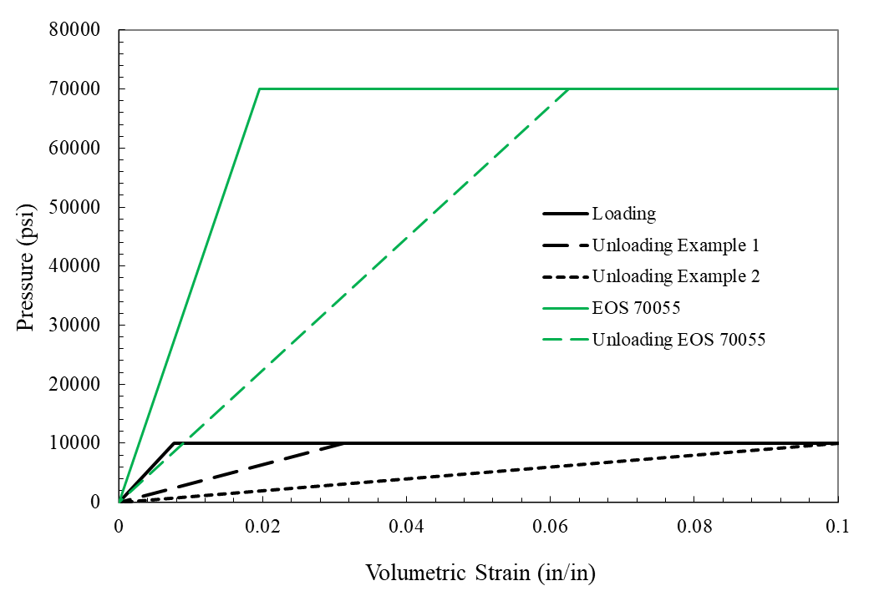
Equation of State 70055 (TABULATED, COMPACTED) used to model the Bulk Modulus as the material transitions from ice to water

Slide 11
Damping
A significant level of damping was observed in the ballistic impact tests
During the original modeling effort many years ago, no attempt was made to characterize, or to model, the source of the energy dissipation

Slide 12
Damping
The source of the damping is probably where the impact plate bolt screws into the block that backs up the load cell
A discrete element that is in parallel with the backup spring was added
  The discrete element references a viscous material (*MAT_DAMPER_VISCOUS)
  The damping value was varied until the decay approximately matched
  The damping does have an affect on peak loads

Slide 13
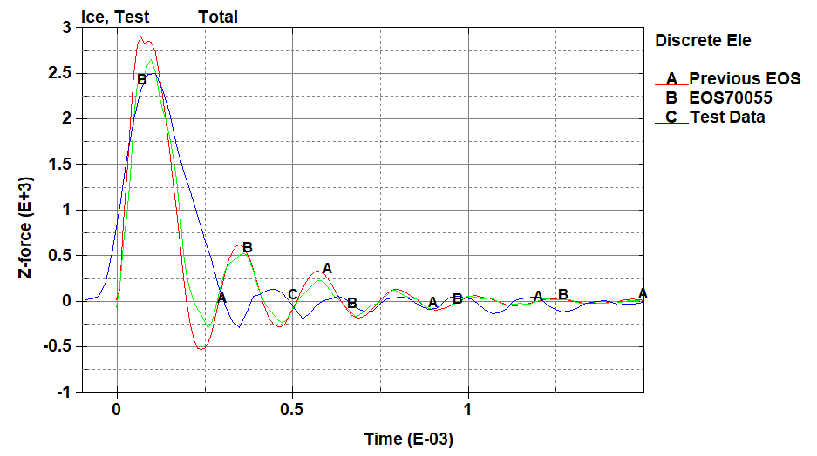
Test Analysis Comparison
The results using EOS 70055 match reasonably well
  The matches for 500 fps isn’t quite as good
    The analytical results 500 fps impact were insensitive to the bi-linear EOS coefficients
    The use of an “official” EOS, which might provide a better match to the 500 fps test result, was beyond the scope of this effort
Note the poor match of the model with the current EOS (1107) to the test data, using a current version of LS-DYNA (with bug fix)
Published and revised EOS with current LS-DYNA R10.1 - 700 fps at 90 deg

Slide 14
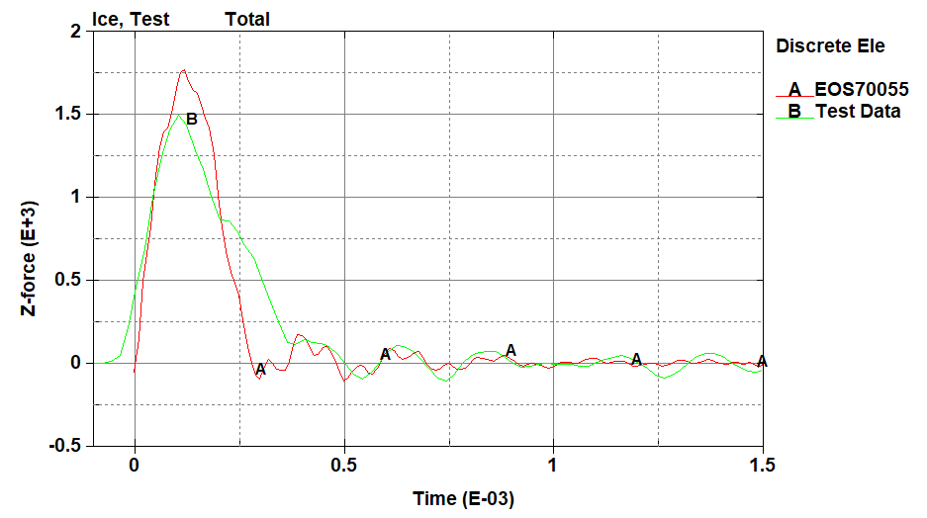
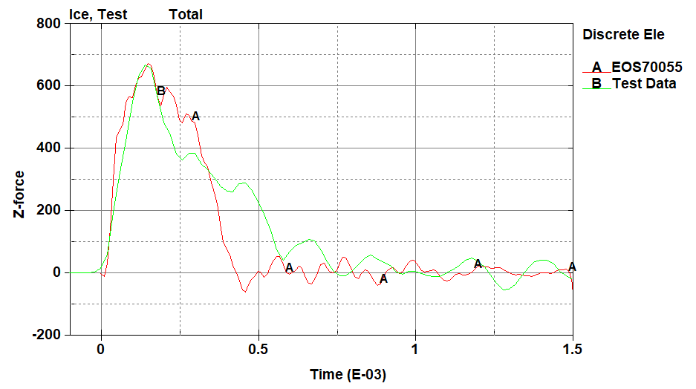
More Comparisons
Revised EOS - 500 fps at 90 deg
Revised EOS - 300 fps at 90 deg

Slide 15
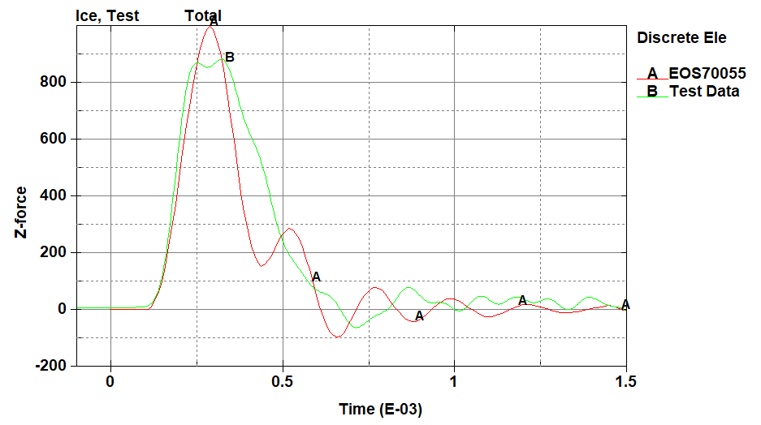
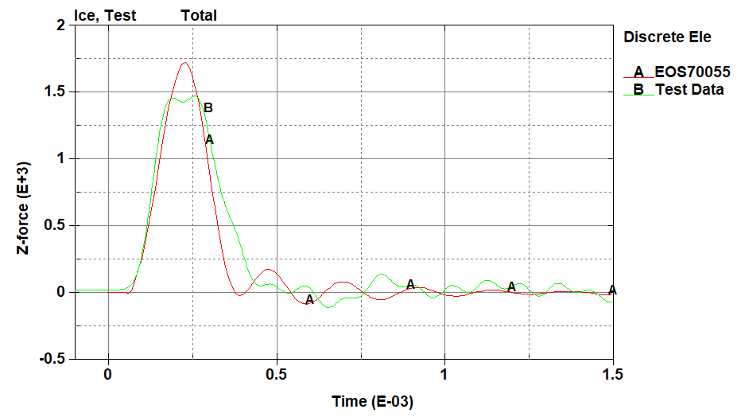
More Comparisons
Revised EOS - 500 fps at 45 deg
Revised EOS - 700 fps at 45 deg

Slide 16
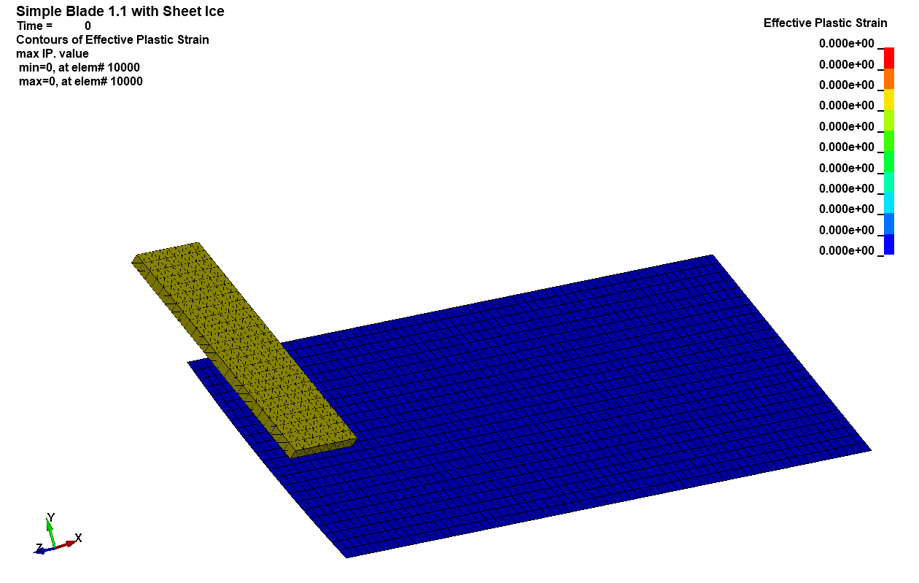
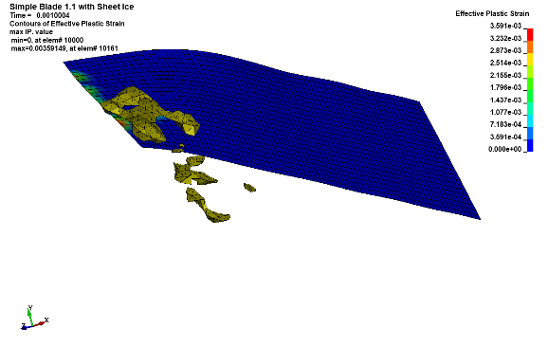
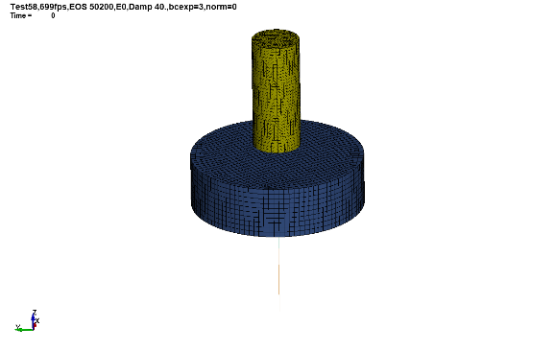
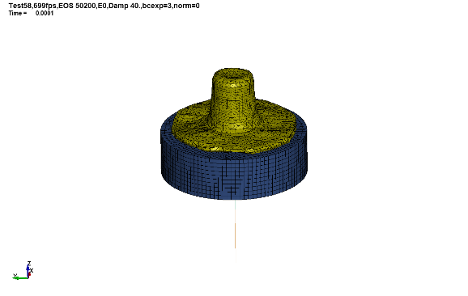
QA Test Case #6
AWG Adopted Recommendation: Use the Revised EOS in Test Case #6
Additional AWG Adopted Recommendation: Use the Ice material validation test model suggested as a replacement for the current AWG ERIF Test Case #6
  The current test case #6 is intended to be a simulation of the FAA ice slab ingestion requirement
    The blade is modeled using coarse shell elements
    Unrealistic geometry
    No test data
    Runs very quickly
  The replacement is a model of the Ice material model validation test
  Realistic geometry
  Results can be compared to test data
  Can be run quickly, if only first period is compared

Slide 17
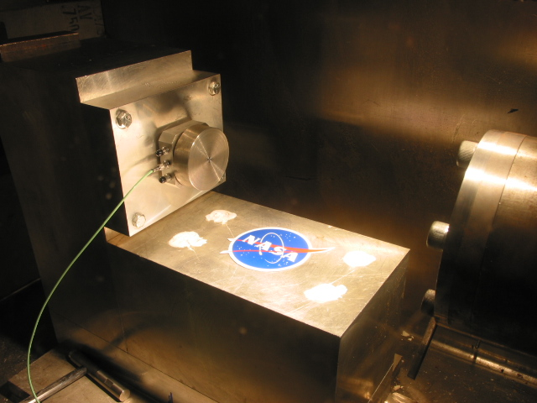
Configuration of Single Load Cell with Plate
Backup Plate with Bolt/Nut Cutout in Back
Ice hits here
Load Cell

Slide 18
LS-DYNA Control Card Recommendations
*CONTROL_ALE
  The default advection logic has been supplemented with an alternate by LSTC
  The alternate algorithm, invoked by setting DCT = -1, is recommended for all problems
    It is especially recommended for simulation of explosives, but this does not mean it shouldn’t be used in impact problems
  With DCT = -1, the results are changed slightly, but non- trivially
    DCT = -1 was used for the EOS creation and should be used in the revised QA Test Case #6
*CONTROL_SOLUTION
  The strain rate sensitivity of the ice model is defined for the wide range of strain rates observed in impact problems
  The default discretization of the load curves leads to differences between the defined load curve and the one actually used by LS-DYNA
  Defining LCINT = 2000 (default is 100), creates many more abscissa values on the internal curves, reducing the differences
    This slows execution, but results in greater accuracy
  Defining the rate sensitivity as a function of the natural logarithm, and option with *MAT_24 and *MAT_224, is not an option with *MAT_155

Slide 19
Conclusion
A previous LS-DYNA bug fixed caused the Ice material model to no longer match test data
  The EOS needed to be updated
The Ice EOS can have a significant affect on forces resulting from ice impact
A revised, simple EOS does a reasonable job matching the impact test data
  The bulk modulus of Ice is highly non-linear
  The revised bulk modulus is bi-linear but in keeping with published ice properties
Revisions to the Ice material model and the associated test case were recommended to the AWG
  This recommendations were adopted by the AWG at the March 2019 meeting

Slide 20
Backup Documentation

Slide 21
Post-Processing Procedure Comments
This procedure is used to compare the analytical results to the test data
Beam Element 1003 represents the washer-type load cell
The loading on the bolt is included in the calibrated test results
The stiffness of the load cell is 4.0 E7 and the stiffness of the bolt is 1.3355 E7
  So the axial force from beam element 1003 must be multiplied by 1.334 to give the total load, and make it comparable to the delivered test load
  Alternately, the axial load of beam 1003 could be added to the axial load of beam 9000200 to get the total load
  The analytical load must also be multiplied by -1
The test forces were filtered to 25,000 Hz by an anti-aliasing filter
  The analytical forces must also be filtered
  I was unable to match the filtering of the test equipment anti-aliasing filter
    The analytical filters in LS-PREPOST do not eliminate all response above the target frequency, which is what these classes of filters do (this is not a bug!)
    Lowering the target frequency until there is no response above 25 kHz is risky, because response below 25 kHz is then also lowered
    As a result, comparing the loads is still a bit of problem due to frequency response above 25 kHz
The solution in the original publication was to average both the test and analytical responses
  I tried, but I couldn’t find a clearly better approach
    I tried filtering both analysis and test to the same lower target frequencies
    This MIGHT be better, but it also might not be, so I stuck with the original approach
  So I continue to use 9 point averaging of the analytical forces
  The time step of the test data is larger, so for a comparable averaging 4 points was used on the test data
    The averaged test data is provided in a separate file, test_700.prn, from the non-averaged data, which is ice58_699.prn

Slide 22
Post-Processing Procedure Summary
This procedure is used to compare the analytical results to the raw test data
  It is recommended that this procedure to not be used in evaluating the Test Case results when used in the QA Suite!
  Compare the axial force from beam element 1003 without processing!
In LS-PREPOST, HIST Menu, plot beam element 1003, axial force
Scale that force by -1.334
Filter using 25,000 Hz, and point average using 9 and save
  I have been using the bandwidth filter, with point averaging, other filters give similar results
In XY Menu, compare to averaged test data
Optionally, plot the unaveraged test data and the scaled and filtered but unaveraged analytical results
  Filter both curves using a bandwidth filter of ~5000 Hz or so
  The peak forces are different from when averaging is used, but the ratios between test and analysis seem similar to when averaging is used

