Slide 1
Material Modeling 2D Examples
Inconel-718 V3 (ASB)
Stefano Dolci, Kelly Carney, Paul DuBois, Steve Kan

Slide 2

SUMMARY
Intro
Boundary Conditions
Input Decks
0.0005 mm NO ASB feature activated
0.2 mm NO ASB feature activated
0.2 mm ASB feature activated
Remarks

Slide 3
Introduction
WARNING: THE ASB FEATURE WORKS ONLY WITH DEV-86797 or later development versions
3 Cases presented:
  0.5µm elements mesh without ASB feature activated
    Baseline adiabatic shear band analysis demonstrated
    ASB feature not required because of small element size
  200µm elements mesh without ASB software activated
  200µm elements mesh with ASB feature activated

Slide 4
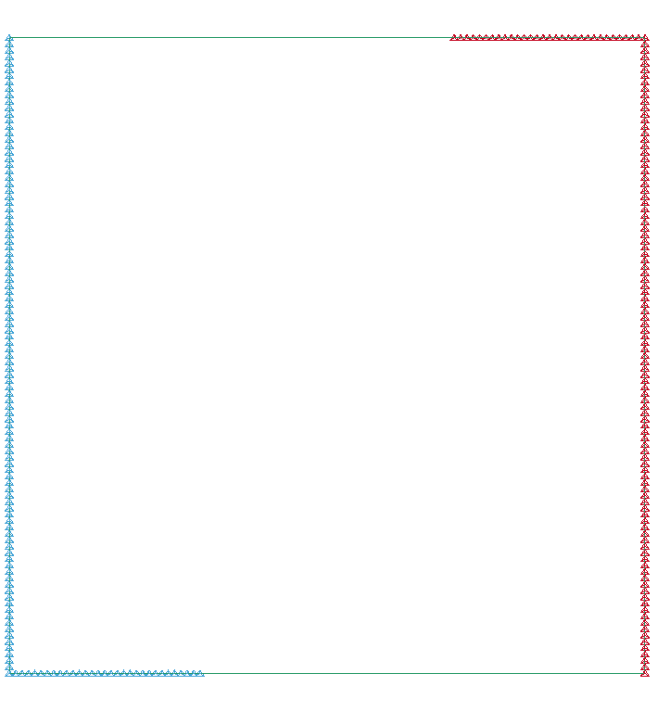
Boundary Conditions
FIXED BOUNDARY
IMPOSED VELOCITY
BOUNDARY

Slide 5
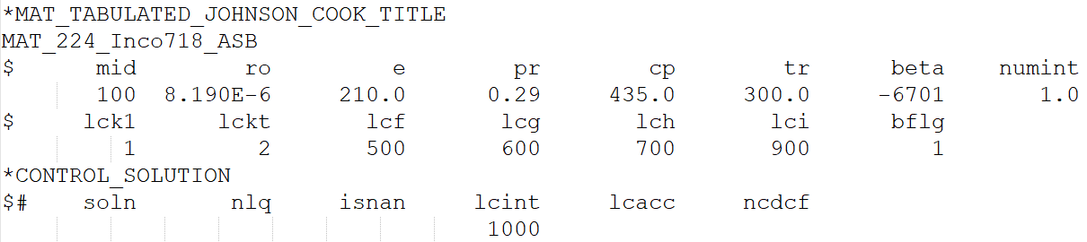
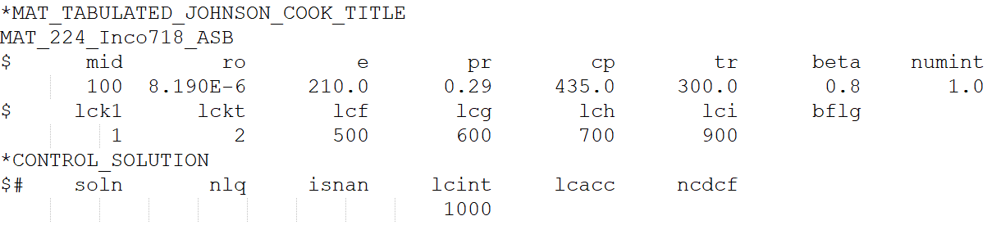
Input Deck
ASB
NO ASB

Slide 6
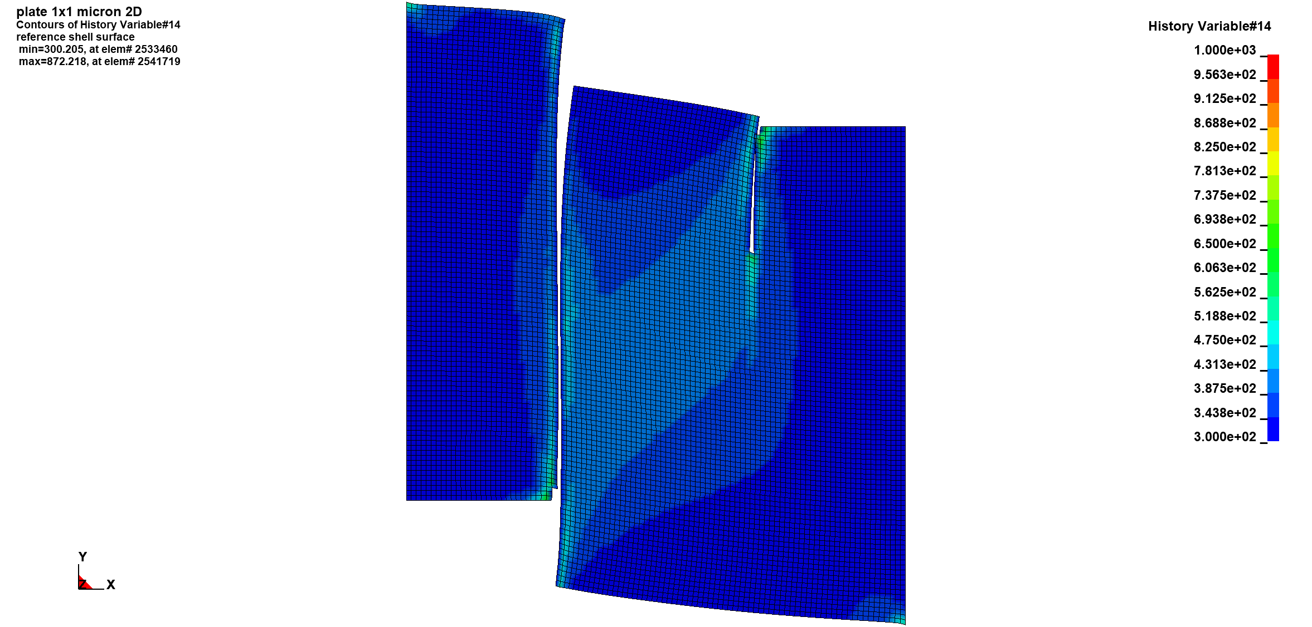
0.0005 mm NO ASB feature – ASB

Slide 7
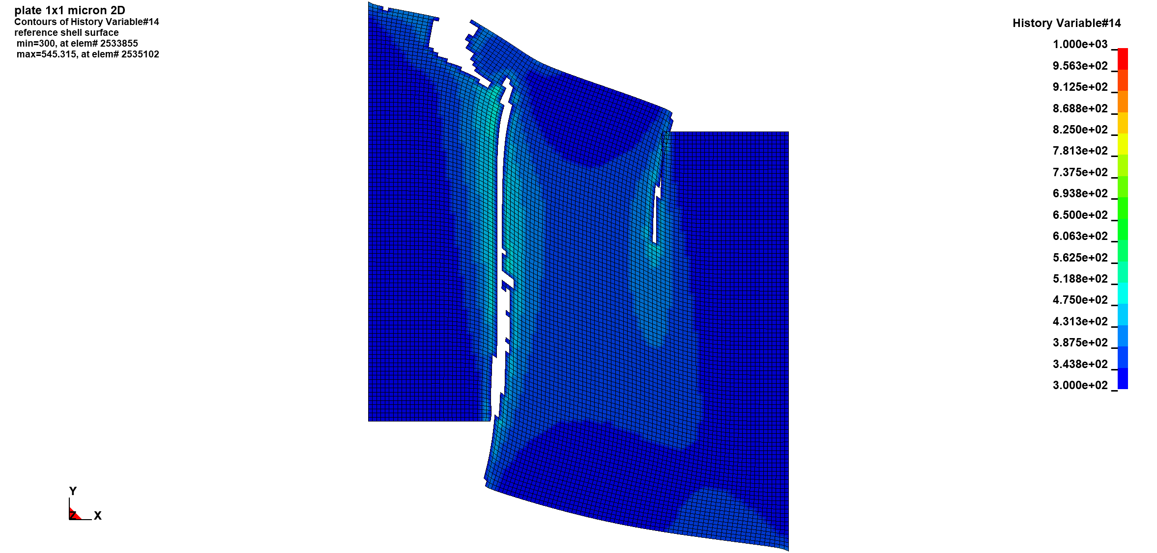
0.2 mm NO ASB feature – No ASB

Slide 8
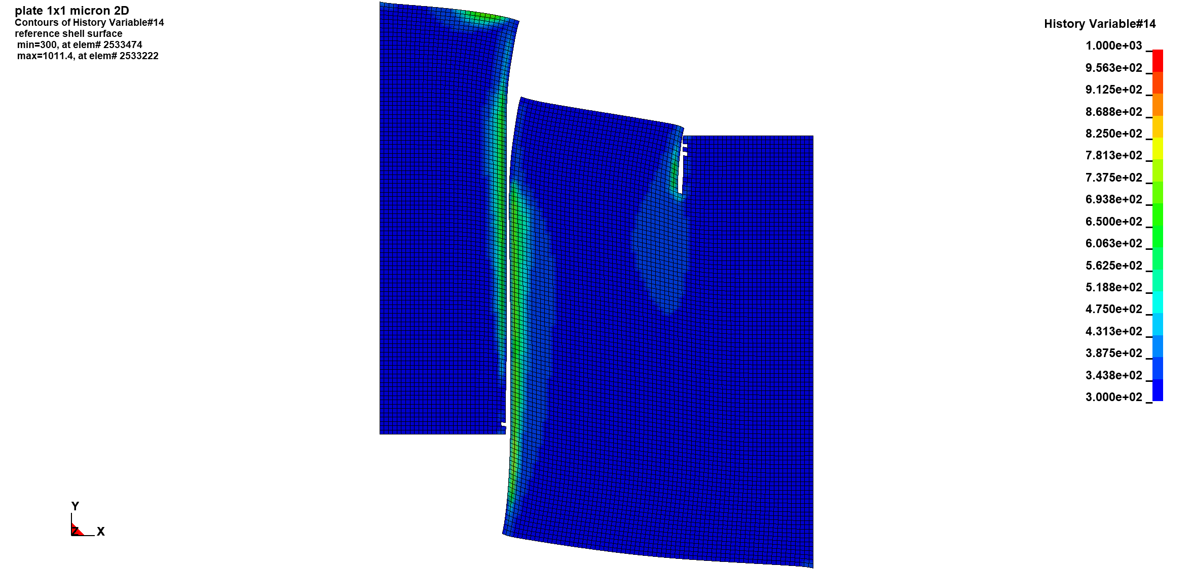
0.2 mm ASB feature - ASB

Slide 9
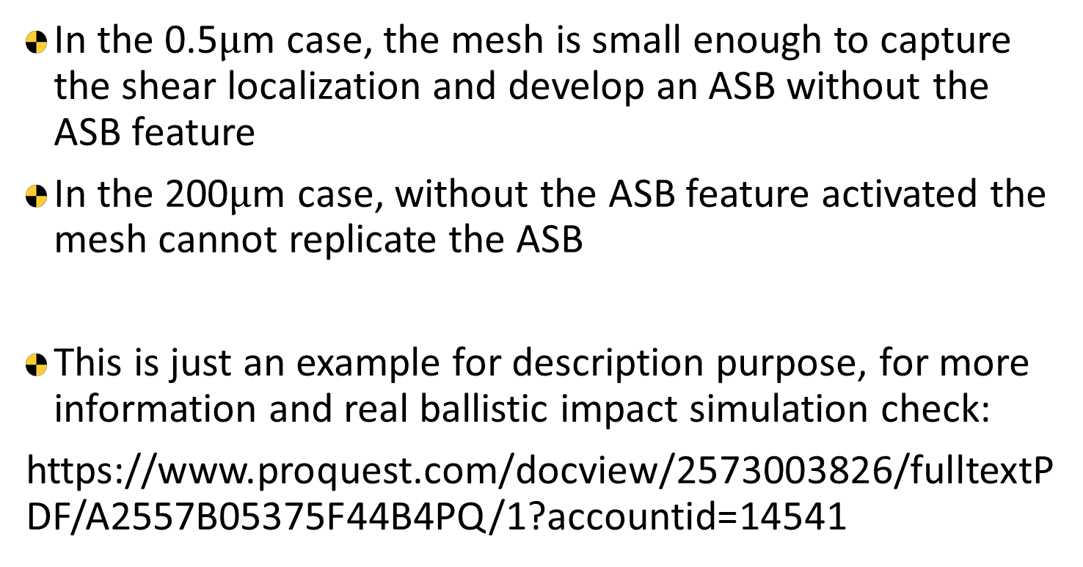
Remarks
In the 0.5$µ$m case, the mesh is small enough to capture the shear localization and develop an ASB without the ASB feature
In the 200$µ$m case, without the ASB feature activated the mesh cannot replicate the ASB
This is just an example for description purpose, for more information and real ballistic impact simulation check:
https://www.proquest.com/docview/2573003826/fulltextPDF/A2557B05375F44B4PQ/1?accountid=14541

